Slide 1
SCHOOL MANAGEMENT SYSTEM
PPT Created by : Preeti kumari

Slide 2
Essentials of Software Foundations and Programming 2 Project
Project Name : School Management System
Project Made By : Preeti Kumari
Project Platform : C/C++
Programming Language used : C++ Programming Language
IDE Tool used : Dev-C++
Project Type : Desktop Application

Slide 3
What is School Management System?
A school management system is used to keep the tracks of students, teachers and employee staffs for school. A school system might have multiple branches within a territory or across the globe. It includes a variety of actors, such as students, employees, teachers, parents of students, and management personnel.

Slide 4
Why do we need school management system?
With the aid of technology, a school administration system aids in efficient communication. Everyone is connected via mobile or online apps, and any information that has to be given can be sent instantly via Chats/SMS. This saves time and eliminates a considerable number of phone calls.

Slide 5
Functionalities used in this Project :
Class and Object
Manipulator Concept
File Handling Concept
Switch Case Concept

Slide 6
Key Features Of This Project :
1 . Insert Student Record .
2. Append Student Record .
3. Modify Student Record .
4. View Student Record .

Slide 7
Source Code :
#include<iostream>
#include<fstream>
#include<iomanip>
#include<string>
using namespace std;
int main()
{

Slide 8
cout<<"\n\t\t\t\t****************************";
cout<<"\n\t\t\t\t* SCHOOL MANAGEMENT SYSTEM *";
cout<<"\n\t\t\t\t****************************";
cout<<"\n\n\t\tWelcome\n";
int course, id;
string n;
string name, clas;
cout<<setw(40)<<setfill('#')<<""<<endl;
cout<<"Enter 1 --> For Inserting Student Records"<<endl;
cout<<"Enter 2 --> For Appending Student Records"<<endl;
cout<<"Enter 3 --> For Modifying Student Records"<<endl;
cout<<"Enter 4 --> For Viewing Records"<<endl;
cout<<"Enter 5 --> For Exit"<<endl;

Slide 9
int r;
cout<<setw(40)<<setfill('#');
cout<<""<<endl;
cout<<"Enter Your Choice:";
cin>>r;
switch(r)
{
case 1 :
{
ofstream obj1;
obj1.open("studetails.txt", ios::out);
cout<<setw(40)<<setfill('#')<<""<<endl;
cout<<"Enter Student Name:";
cin>>name;
cout<<"Enter Student Roll No :";

Slide 10
cin>>id;
cout<<"Enter Student Class :";
cin>>clas;
cout<<"Enter Student Course :";
cin>>course;
obj1<<setw(40)<<setfill('#')<<""<<endl<<"Student Detail"<<endl<<endl;
obj1<<"Student Name:"<<name<<endl;
obj1<<"Student Roll No:"<<id<<endl;
obj1<<"Student Class:"<<clas<<endl;
obj1<<"Student Course:"<<course<<endl;
obj1.close();
break;
}
case 2 :
{

Slide 11
ofstream obj2;
obj2.open("studetails.txt", ios::app);
obj2<<setw(40)<<setfill('#')<<""<<endl<<"Updated Records"<<endl<<endl;
cout<<"Enter New Student Name:";
cin>>name;
cout<<"Enter New Roll No:";
cin>>id;
cout<<"Enter New Class :";
cin>>clas;
cout<<"Enter New Course Enrolled:";
cin>>course;
obj2<<"Edited Student Name:"<<name<<endl;
obj2<<"Edited Student Roll No:"<<id<<endl;

Slide 12
obj2<<"Edited Class:"<<clas<<endl;
obj2<<"Edited Course Enrolled:"<<course<<endl;
obj2.close();
break;
}
case 3 :
{
ofstream obj3;
obj3.open("studetails.txt", ios::out);
obj3<<setw(40)<<setfill('#')<<""<<endl<<"Overwritten Data"<<endl;
cout<<"Enter New Student Name:";
cin>>name;

Slide 13
cout<<"Enter Roll No:";
cin>>id;
cout<<"Enter Class:";
cin>>clas;
cout<<"Enter Course Enrolled:";
cin>>course;
obj3<<"\nEnter New Student Name:"<<name;
obj3<<"\nEnter New Roll No:"<<id;
obj3<<"\nEnter New Class:"<<clas;
obj3<<"\nEnter New Course Details:"<<course<<endl;
obj3.close();
break;
}

Slide 14
case 4 :
{
string print;
ifstream abc;
abc.open("studetails.txt", ios::in);
while(getline(abc, print))
{
cout<<print<<endl;
}
abc.close();
}
case 5 :
{
break;
}
}
}

Slide 15
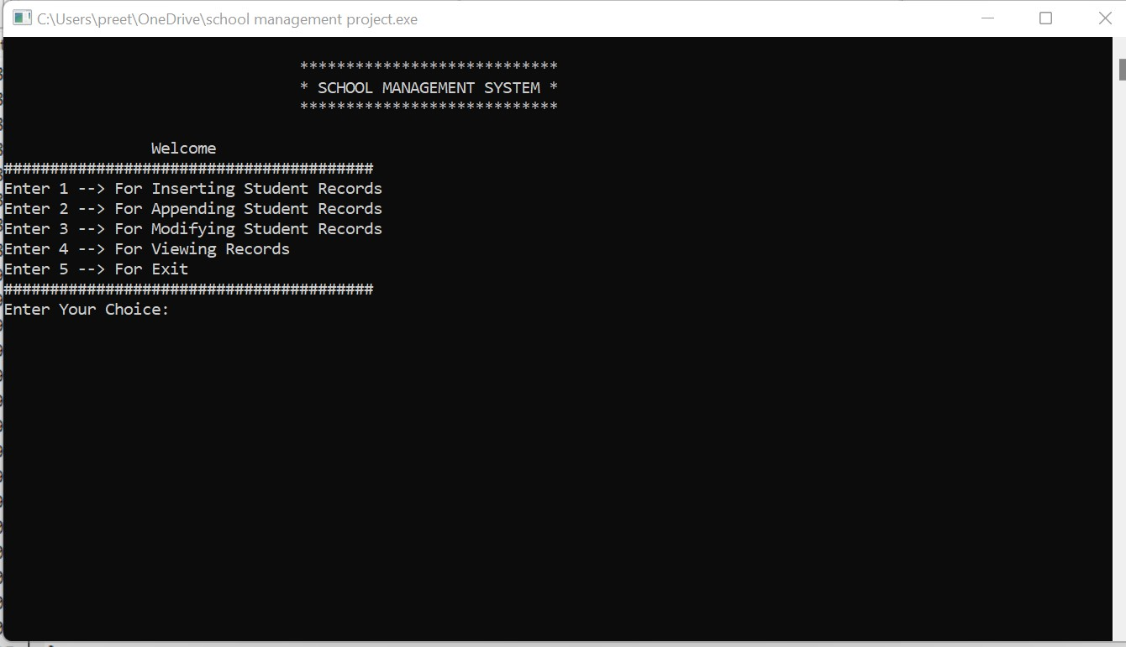
Output Of This Source Code : Here is the main menu when we run our code in the compiler

Slide 16
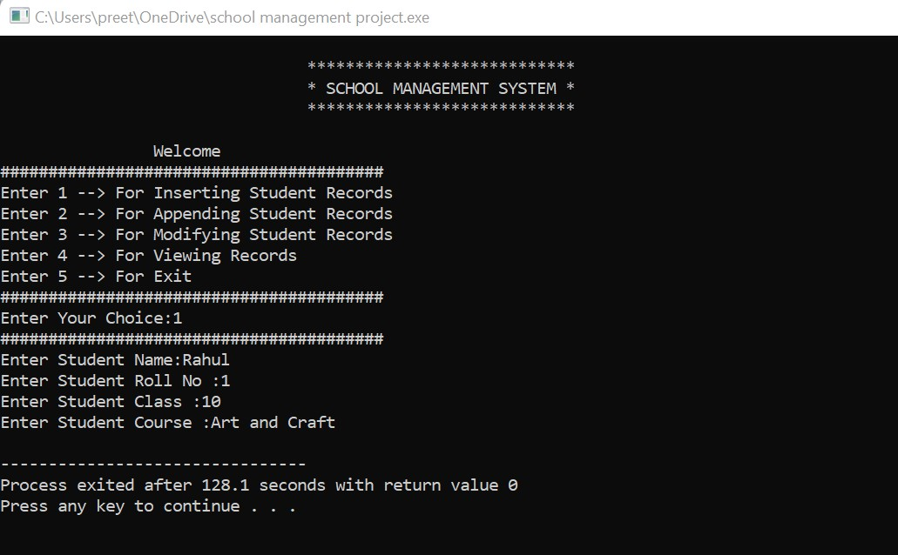
Now For Inserting Data :

Slide 17
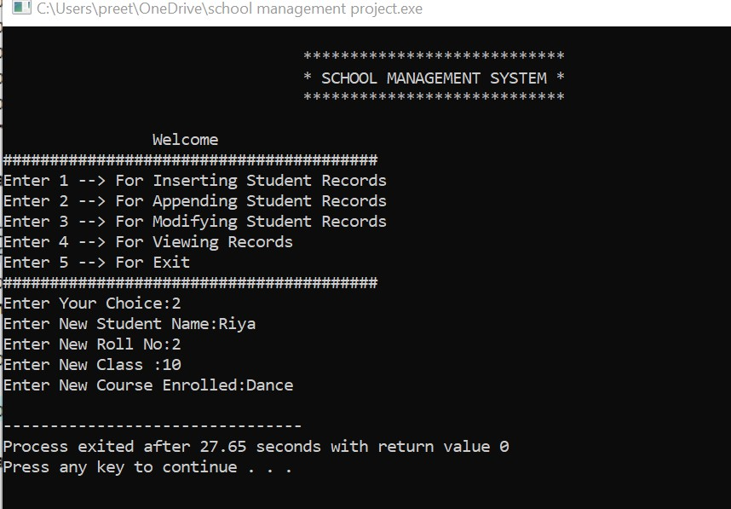
Now For Appending Data :

Slide 18
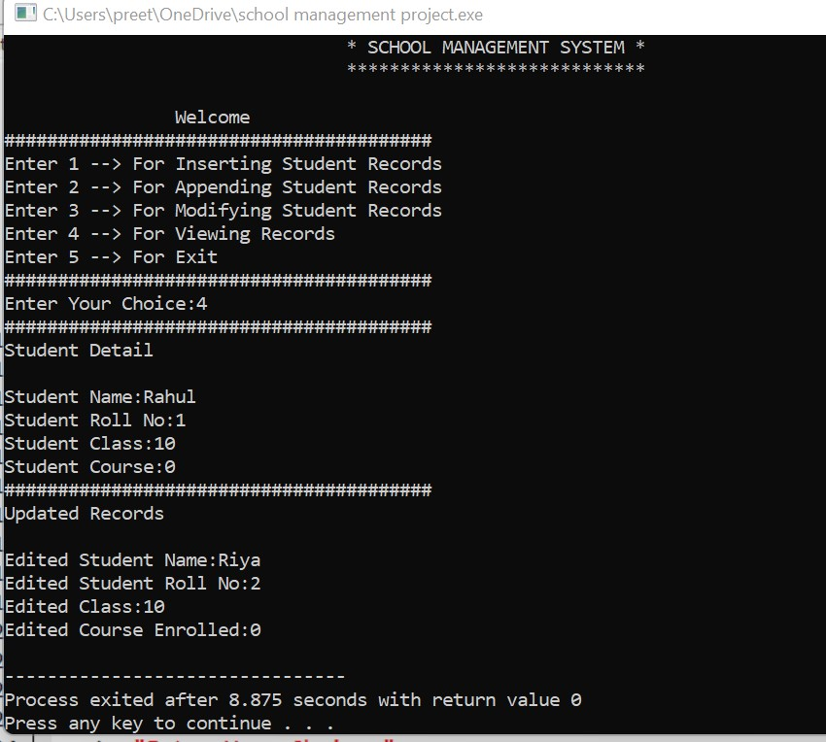
Now For Viewing Data

Slide 19
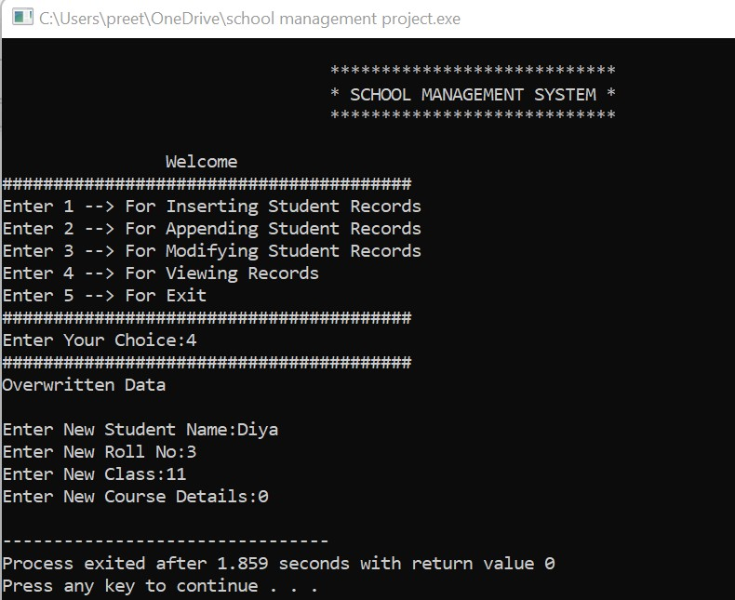
Now For Modifying Data :

Slide 20
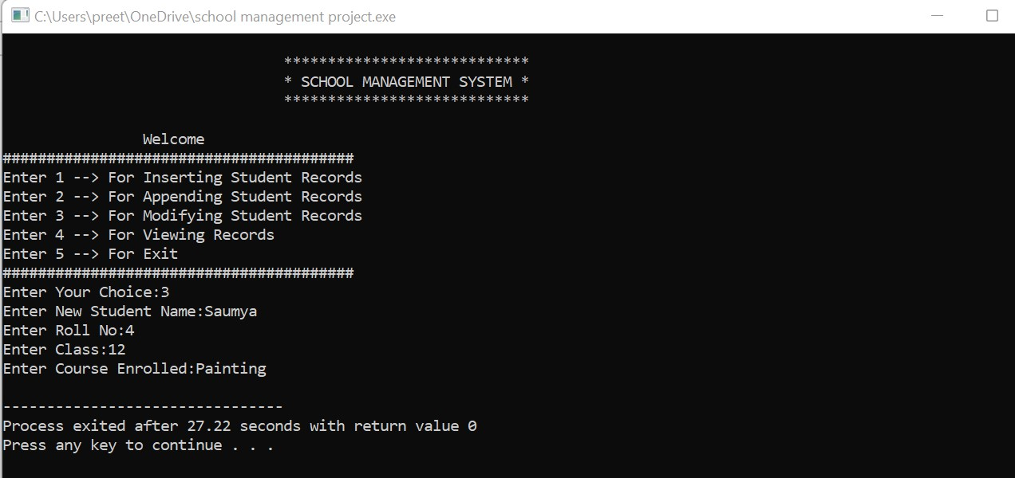

Slide 21
Conclusion :
In conclusion, School Management System in C++ can be beneficial to students or professionals interested in learning the C++ programming language. This project can also be customized to meet your specific needs.

Slide 22
THANK YOU…

